Slide 1
UE17CS490A – Capstone Project Phase – 1
End Semester Assessment
Project Title : Intelligent Fashion Generation and
Retrieval System
Project ID : PW21KS09
Project Guide : Mr K.S. Srinivas
Project Team : Daksha Singhal PES1201700847
Kavya Khatter PES1201701136
Adithya Vardhan PES1201700788

Slide 2
Agenda
Problem Statement
Abstract and Scope
Literature Survey
Suggestions from Review – 3
Design Approach
Design Constraints, Assumptions & Dependencies
Proposed Methodology / Approach
Architecture
Design Description
Technologies Used
Project Progress
References

Slide 3
Problem Statement
Competitive pressures are becoming higher and global demand continues to ask for new collections rapidly. Fast fashion is an economic phenomenon that has allowed everyone to dress following the latest trends.
We aim to ease the user experience by providing them with an option to create new designs from their existing designs.
Notes:
kavya

Slide 4
Abstract and Scope
The fashion industry has always been one of the most lucrative markets in terms of products and design. Every designer is always looking for new ways to come up with ideas and inspirations. Every new design and concept could be a new trend in fashion. In this project, we will discuss the applications of Generative Models to train and develop a vast array of fashion apparel, given an adequate dataset. Characteristics such as texture, shape, design and material are some of the parameters that we take into consideration while creating variations in the output.Features, specific to a designer, can be achieved by loading the previous works of the designer into the model.
Such applications would find an interesting use case in designer boutiques such as H&M and ZARA as well as existing online boutiques such as SHEIN.
Notes:
kavya

Slide 5
Literature Survey
Reference | DeepWear: a Case Study of Collaborative Design between Human and Artificial Intelligence, Natsumi Kato, Naoya Muramatsu , Hiroyuki Osone, Yoichi Ochiai , Daitetsu Sato University of Tsukuba
Abstract | DeepWear is a practical designing clothes system to generate images and designers make clothes by receiving instruction from those images
Dataset | Collected images of a specific brand announced between 2014 and 2017
Model | DC-GANs
Pros | Useful to learn unsupervised image representations
Cons | low Resolution
Notes:
D

Slide 6
Literature Survey
Reference | A Style-Based Generator Architecture for Generative Adversarial Networks, Tero Karras ,Samuli Laine, Timo Aila NVIDIA
Abstract | StyleGANS are automatically learned, unsupervised separation of high-level attributes and stochastic variation in the generated images and enabling intuitive, scale-specific control of the synthesis.
Dataset | Celeb Dataset
Model | Style GAN
Pros | Useful to learn unsupervised image representations as well as high quality images
Cons | Requires Powerful GPU
Notes:
D

Slide 7
Literature Survey
Reference | Photo-Realistic Single Image Super-Resolution Using a Generative Adversarial Network, Christian Ledig, Lucas Theis, Ferenc Huszar, Jose Caballero, Andrew Cunningham, Alejandro Acosta, Andrew Aitken, Alykhan Tejani, Johannes Totz, Zehan Wang, Wenzhe Shi Twitter
Abstract | General Adversarial Network capable of inferring photo-realistic natural images of 4x upscale factor
Dataset | A database of human segmented natural images
Model | GANs
Pros | Useful for improving quality of low-resolution images
Cons | Good chance of mode-Collapse issue
Notes:
A

Slide 8
Literature Survey
Reference | On Single Image Scale-Up Using Sparse-Representations, Roman Zeyde, Michael Elad, and Matan Protter
Abstract | Single image scale-up problem using sparse-representation modeling to recover an original image from its blurred and down-scaled noisy version
Dataset | Collected set of high resolution images
Model | Convoluted Neural Networks
Pros | Much faster than other similar algorithms due to the use of Dimensionality Reduction and PCA
Cons | If the generated image is blurred, the final image will be blurred too
Notes:
A

Slide 9
Literature Survey
Reference | Generate High Resolution Images With Generative Autoencoder , A. Sagar, Vellore Institute of Technology
Abstract | We use a discriminator in place of the decoder while inputting values from the encoder as well as the generator and allow the discriminator to discern the real images.
Dataset | MNIST, LSUN and CelebA-HQ dataset
Model | Generative Adversarial Network with AutoEncoder
Pros | Solves the mode-collapse issue of image generation in GANs while also solving the blurring effect in image generation from VAEs
Cons | NA
Notes:
A

Slide 10
Suggestions from Review - 3
Feedback:Increase the resolution of generated designs
Image quality measurement metric
We have now generated new designs for 64 resolution.
Notes:
K

Slide 11
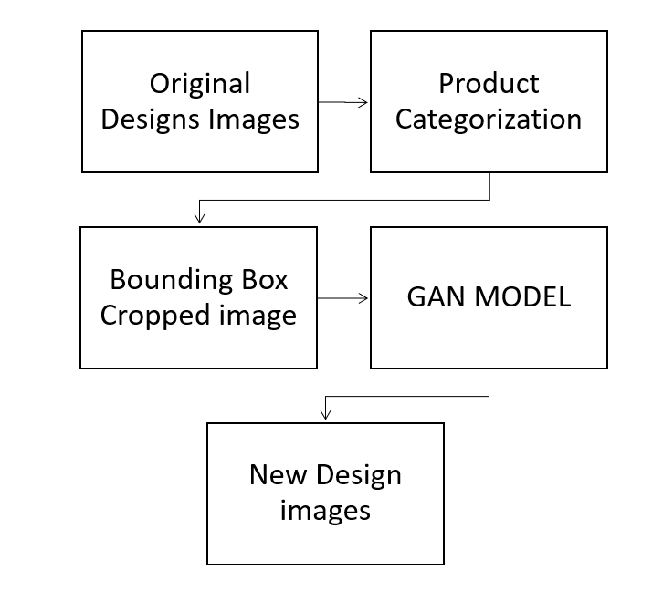
Design Approach
Notes:
K

Slide 12
Design Constraints, Assumptions & Dependencies
Dependencies:
Hardware requirements:Powerful GPUs
Assumptions:
Designers are willing to share their designs for our model to work as a service for them.
Images passed into the model for training should be of high resolution
Risks:
Obtaining high resolution of the new fashion apparel is one of the challenge.
Powerful GPU requirement should be fulfilled.
Notes:
D

Slide 13
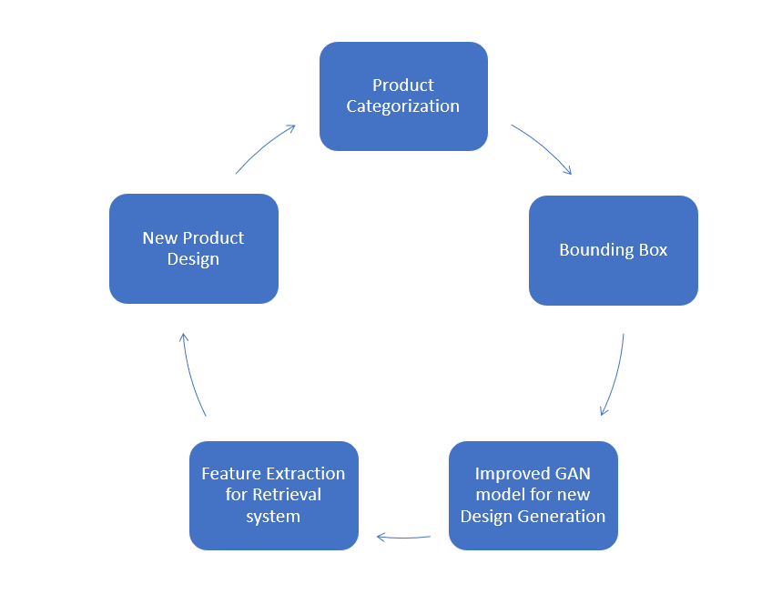
Proposed Methodology / Approach
Previous research works propose different methods to retain the patterns, colour and texture along with certain pros and cons. We aim to overcome those limitations and generate new fashion apparels.
Notes:
D

Slide 14
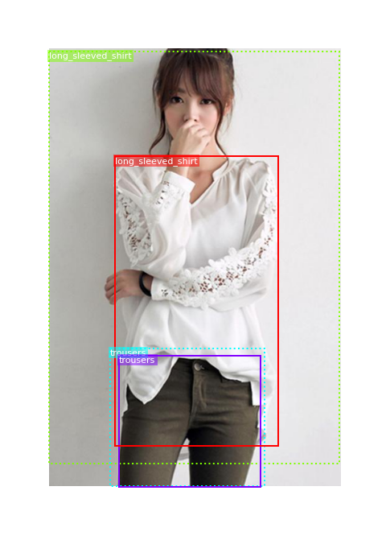
Proposed Methodology / Approach
Product Categorization:Given input images of different fashion styles we aim to first classify the images into a predefined categories
T-Shirt (0) | Trouser (1) | Pullover (2) | Dress (3) | Coat (4)
Sandal (5) | Shirt (6) | Sneaker (7) | Bag (8) | Ankle Boot (9)
Bounding Box:Cropping based on different apparels of the human pose image
Notes:
D

Slide 15
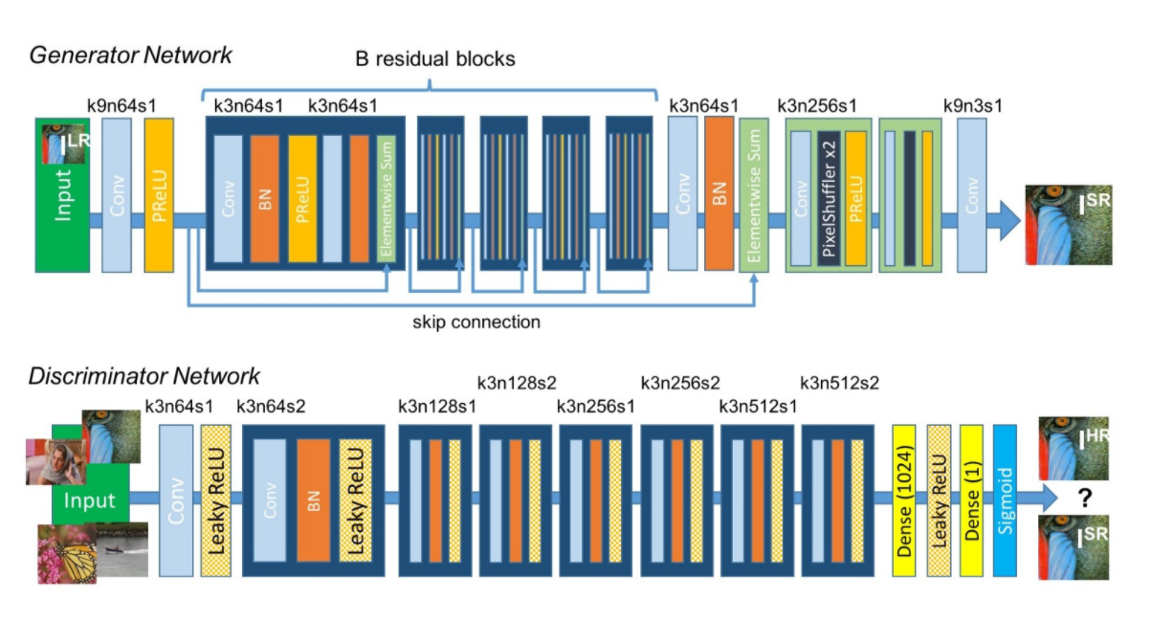
Proposed Methodology / Approach
Generating Design Apparels:
the model incorporated to generate high-resolution apparel images using DC-GANS and SR-GANS
Notes:
D

Slide 16
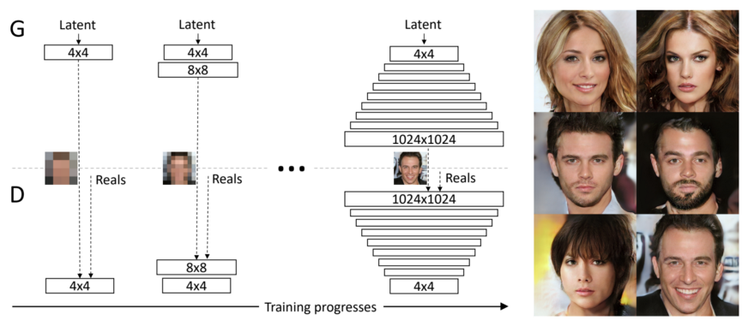
Proposed Methodology / Approach
Generating Design Apparels:
the model incorporated to generate high-resolution apparel images using PG-GANS
Notes:
K

Slide 17
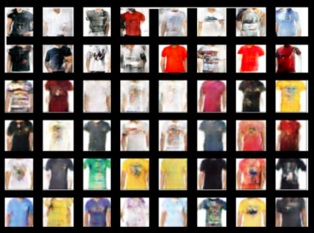
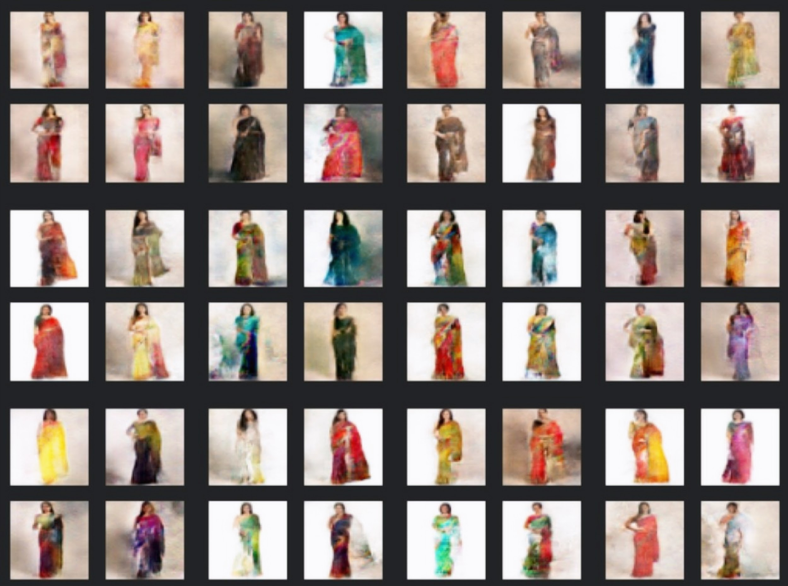
Proposed Methodology / Approach
Results
DC GANS generated designs for 64 resolution
Notes:
K

Slide 18
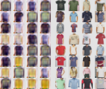
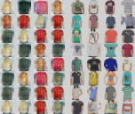
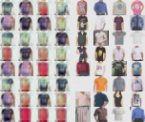
Proposed Methodology / Approach
Results
PGANS generated designs for 16 resolution
Notes:
K

Slide 19
Proposed Methodology / Approach
Metric for calculating Image Quality: BRISQUE
Calculates the no-reference image quality score for image using the Blind/Referenceless Image Spatial Quality Evaluator
Average BRISQUE SCORE for the generated images : 34
Notes:
K

Slide 20
Architecture Choices
Local Processing:
To allow the clients to provide for their own Processing units based on their requirements. This allowed clients to choose the application architecture based on their constraints and requirements.
Pros:
Faster retrieval of designs
smaller transfer time
requirement specific hardware
Cons:
Fixed specs of hardware. Harder to change in case of a shift of requirements
Added expense to the client
Notes:
A

Slide 21
Architecture Choices
2. Local Storage:
To allow clients to store designs on local storage devices. This allows clients to set up their own data architecture and hardware specific to their requirements.
Pros:
Faster dataset retrieval
Improved security
Client-specific hardware
Cons:
Slower data retrieval for Processing unit
Incompatible data architectures
Data Redundancy
Added expense to the client
Scalability
Notes:
A

Slide 22
Architecture Choices
3. Cloud Storage and Processing:
To provide for Data storage and processing units based on the agreed requirements set by the client
Pros:
Data redundancy
Easy scalability
Dynamic requisition of resources based on requirements
Compatible storage architecture
Cons:
Slower Data Retrieval
Network constraints
Therefore, Cloud storage and Processing architecture is the most suitable for our product.
Notes:
A

Slide 23
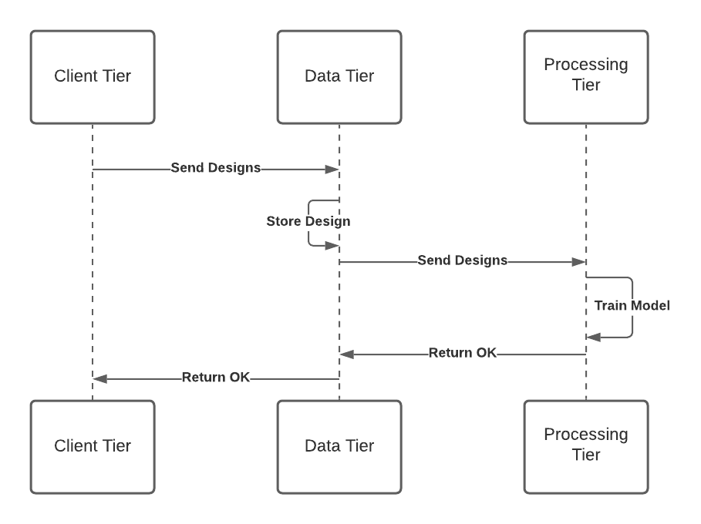
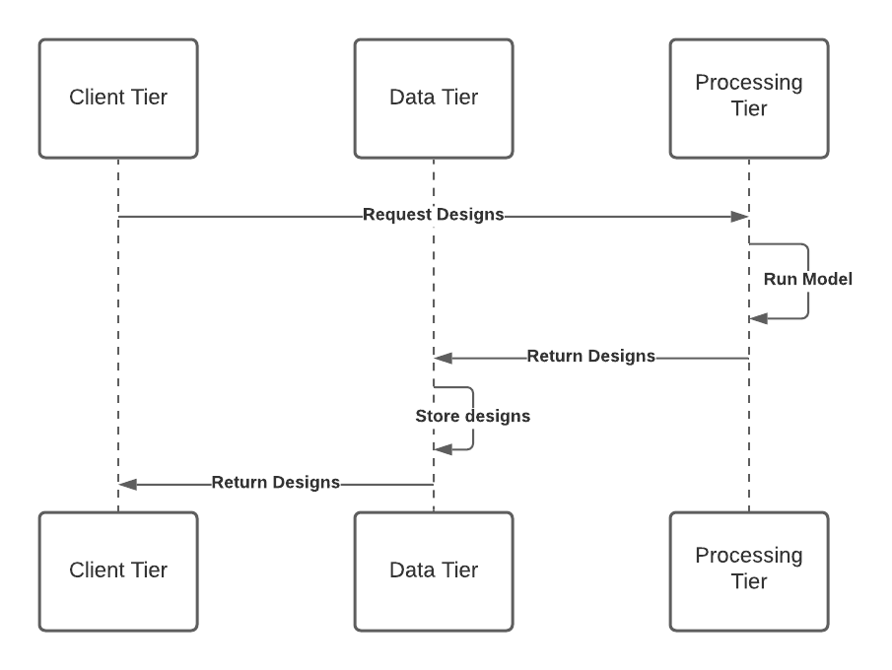
Architecture
Interaction diagram
Interaction Diagram for Train Model
Interaction Diagram for Generate Design
Notes:
A

Slide 24
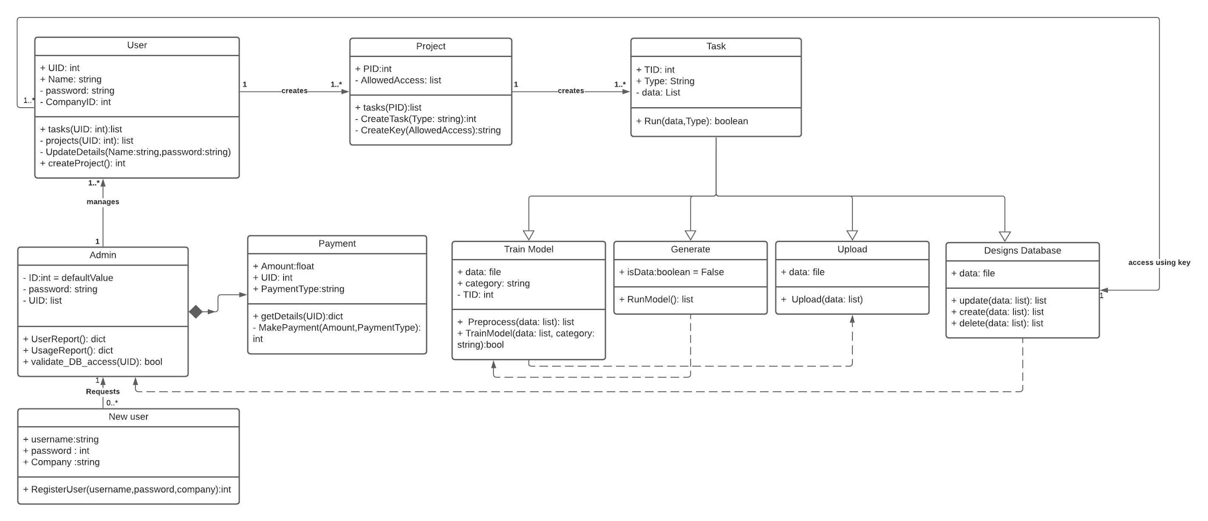
Design Description
Master class diagram
Notes:
A

Slide 25
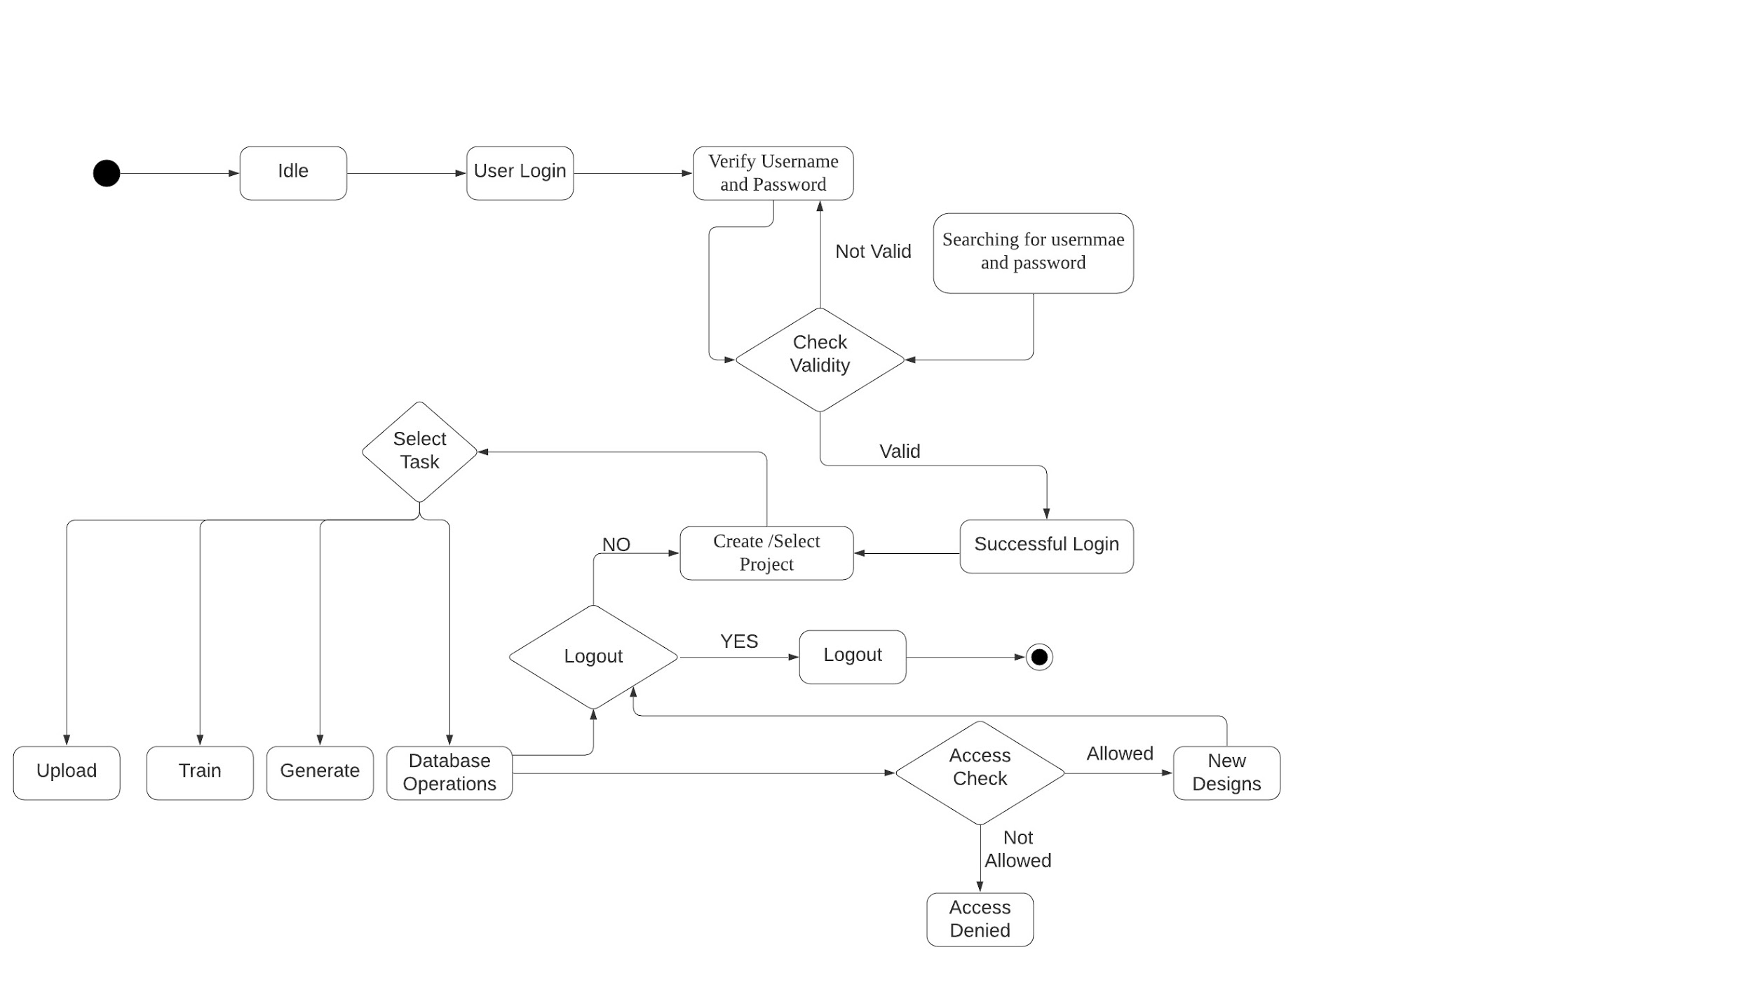
Design Description (if applicable)
Activity Diagram
Notes:
A

Slide 26
Technologies Used
Python 3
Keras, Tensorflow
opencv
Frontend
HTML
CSS
Javascript
Bootstrap
Backend
Flask
Notes:
A

Slide 27
Project Progress
We have successfully built an application where the client can request for new designs by inputting his original design images. For generating new designs we have implemented 2 GAN models i.e. DC-GANs and P-GANS, both provided us with the desired results given the good quality adequate number of images.
The project progress is 60%
Notes:
D

Slide 28
References
[1] Natsumi Kato, Naoya Muramatsu, Hiroyuki Ozone, Yoichi Ochiai, Daitetsu Sato University of Tsukuba, DeepWear: a Case Study of Collaborative Design between Human and Artificial Intelligence
[2] Tero Karras, Samuli Laine, Timo Aila NVIDIA, A Style-Based Generator Architecture for Generative Adversarial Networks
[3] Christian Ledig, Lucas Theis, Ferenc Huszar, Jose Caballero, Andrew Cunningham, Alejandro Acosta, Andrew Aitken, Alykhan Tejani, Johannes Totz, Zehan Wang, Wenzhe Shi Twitter, Photo-Realistic Single Image Super-Resolution Using a Generative Adversarial Network
[4] Roman Zeyde, Michael Elad, and Matan Protter, On Single Image Scale-Up Using Sparse-Representations
[5] Alec Radford, Luke Metz, and Soumith Chintala, Unsupervised representation learning with deep convolutional generative adversarial networks In International Conference on Learning Representations (ICLR), 2016.
[6] Seyedarian Hosseini, Thomas Boquet, Wojciech Stokowiec, Ying Zhang, Christian Jauvin, Chris Pal, Fashion-Gen: The Generative Fashion Dataset and Challenge
[7] Y. Pu, Z. Gan, R. Henao, X. Yuan, C. Li, A. Stevens, and L. Carin, Variational autoencoder for deep learning of images, labels and captions,
in Advances in neural information processing systems, 2016, pp. 2352–2360.
[8] Yanghua Jin, Jiakai Zhang, Minjun Li, Yingtao Tian,Huachun Zhu, and Zhihao Fang. 2017. Towards the Automatic Anime Characters Creation with Generative Adversarial Networks. arXiv preprint arXiv:1708.05509 (2017).
[9] Phillip Isola, Jun-Yan Zhu, Tinghui Zhou, and Alexei A Efros. 2016. Image-to-image translation with conditional adversarial networks. arXiv preprint arXiv:1611.07004 (2016).
[10] Ian Goodfellow, Jean Pouget-Abadie, Mehdi Mirza, Bing Xu, David Warde-Farley, Sherjil Ozair, Aaron Courville, and Yoshua Bengio. 2014. Generative adversarial nets. In Advances in neural information processing systems. 2672–2680.
[11] Yang Hu, Xi Yi, and Larry S Davis. 2015. Collaborative fashion recommendation: A functional tensor factorization approach. In Proceedings of the 23rd ACM international conference on Multimedia. ACM, 129–138.
[12] Lixuan Yang, Helena Rodriguez, Michel Crucianu, and Marin Ferecatu. 2017. Fully Convolutional Network with Superpixel Parsing for Fashion Web Image Segmentation. In International Conference on Multimedia Modeling. Springer, 139–151.

Slide 29
Thank You

